Slide 1
RECON WITH THE GIRLSQUAD

Slide 2
What will we learn today
Introduction to Reconnaissance
A few demos to get started
Hosts Discovery
Subdomain Discovery
Web Servers & Outbound connections
Information gathering

Slide 3






MRIGAKSHI GOEL
Application Security Analyst - Bugcrowd
SARGUN WALIA
Malware Research Analyst Co-Op
NOKIA
MARYAM NOURAFKAN
Cybersecurity researcher
MANJOT KAUR
Cybersecurity researcher / enthusiast
SAVREEN KAUR
Security Analyst - Canadian Natural Resources Limited

Slide 4
Agenda
Recon -first Step
How I Start
Common Recon Techniques
Basic Recon

Slide 5


Slide 6
Reconnaissance is the first step a Hacker/Pentester/Bug-bounty hunter will take
Job advertisements
Search engines like google, bing and yahoo
LinkedIn Facebook Twitter and the like
Whois search
Crunchbase for acquisitions
Wayback searches old urls

Slide 7
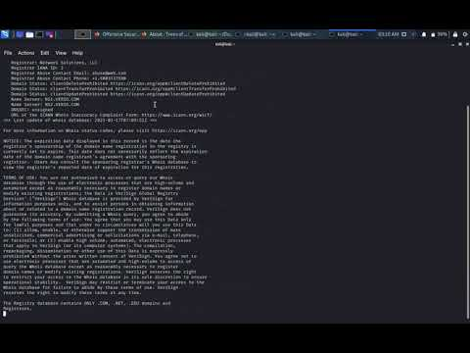
Whois
Notes:
Social engineering: This technique involves looking for reasoning to gain sensitive information or text by stimulating an individual mind or sense of social norms.
•
Dumpster diving: This technique involves obtaining sensitive information from trash locations.
•
Usenet tools: This technique depends on gathering data from company websites, gathering information from employees' social networks, or collecting some useful information from business partners.
•
Domain name system (DNS) reconnaissance–zone transfer: A DNS server can be a good place for hackers to harvest important information such as an address of a mail server, an address of a web server, operation system information, and even comments.

Slide 8
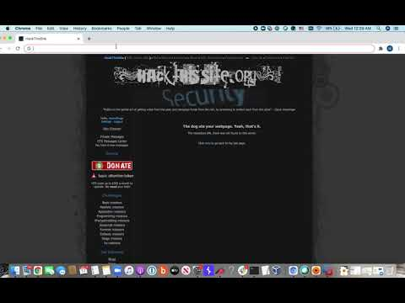
Manual Recon

Slide 9
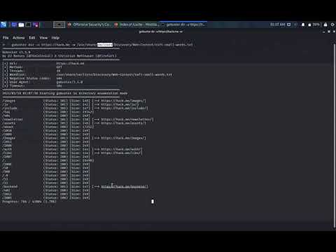

Slide 10
Basic Recon
IP range / CIDR
MXtoolbox / Domaintoipconverter
Favicon hashes
https://anywebsite/favicon.ico => favicon hash => search shodan.io
Format => http.favicon.hash: 709737812
SSL Certificates
Any website with an HTTPS web address uses SSL/TLS.

Slide 11
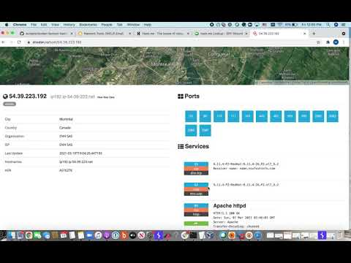
Quick Demo

Slide 12
Up Next
Hosts and Subdomain
DNS Records
Web Servers
Outbound connections
Information gathering

Slide 13
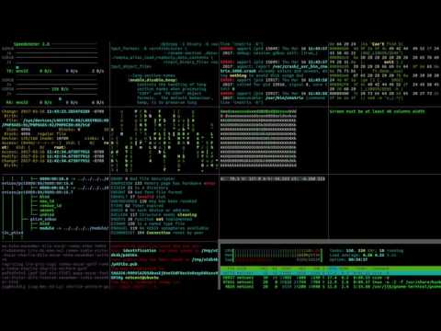

Slide 14
Agenda
What is host discovery?
Popular scanning tools
Types of ports
Scanning using Nmap

Slide 15
Host Discovery
Used to reduce the number of hosts in a network
Host discovery can be performed in 3 ways -
Network Scanning
Port scanning
Vulnerability Scanning
Goal is to have a list of targets for the next stage i.e. exploitation

Slide 16
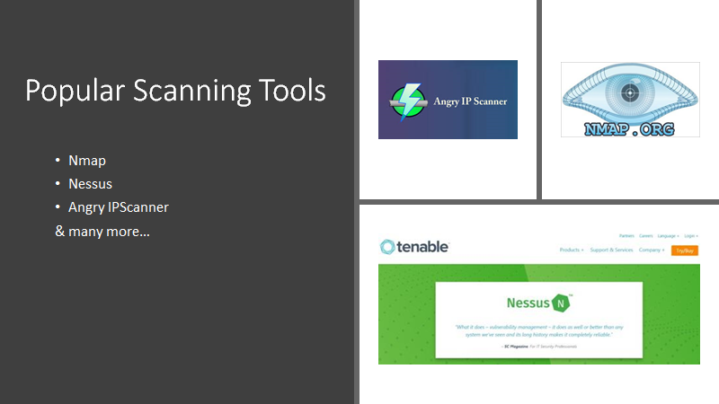

Slide 17
Types of Ports
open
closed
filtered
unfiltered
open|filtered
closed|filtered

Slide 18
Scanning Using Nmap
Different options of using nmap to find information -
Ping hosts -> nmap -sP <target>
OS version -> nmap -O <target>
Services -> nmap -sV <target>

Slide 19

Performing Nmap on Kali Linux

Slide 20
How to prevent Scanning?
Keep not in use ports closed
Use firewalls, IDS, IPS
Patch your services
Install updates

Slide 22
Host Information: Domains and Subdomains
Agenda
Introduction
Domains and subdomains
Tools
Subdomain takeover
How to prevent

Slide 23
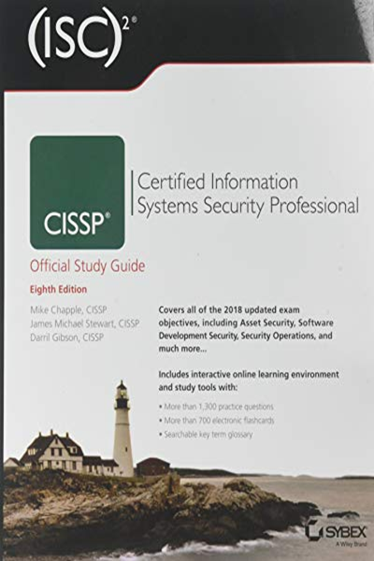
Introduction
CISSP Official Study Guide:
Reconnaissance or information gathering
Finding weak points

Slide 24
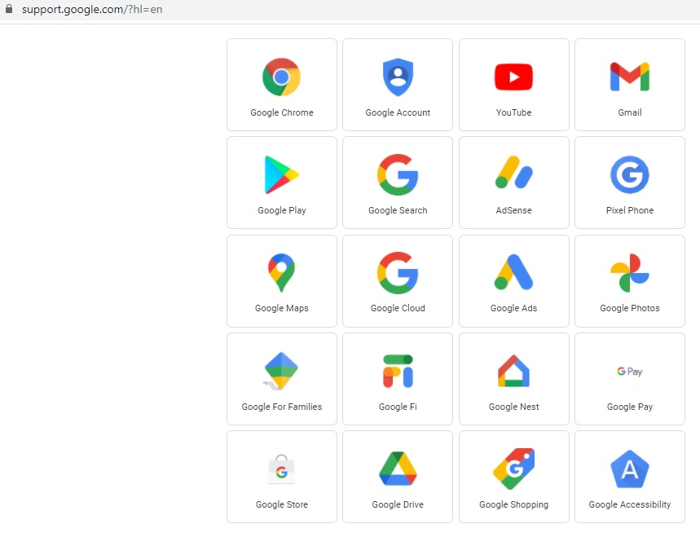
Domains and Subdomains
Subdomain?
Example:
Assistance with any Google apps: https://support.google.com/
Discovering subdomains
unsecured subdomain

Slide 25

Tools for Finding Subdomains
Tools to find the subdomains of any domains:
AMASS
SubBrute
Knock
DNSRecon
DNS Dumpster
Spyse

Slide 26
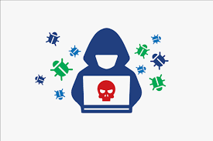
Subdomain Takeover
When an attacker gains control over a subdomain of a target domain:
Provisioning
Deprovisioning (removing) a virtual host
Consequences:
read cookies set from the main domain
perform cross-site scripting
circumvent content security policies

Slide 27
How to Prevent?
Start provisioning by claiming the virtual host create DNS records last
Start deprovisioning by removing DNS records first
Create an inventory of all of your organization’s domains and their hosting providers, and update it as things change
Put pressure on hosting vendors to close gaps
Ask how they verify that someone claiming a virtual host

Slide 29
Agenda
Web Servers
Vhosts
SSRF (Server Side Request Forgery)
Pingbacks

Slide 30
Web Servers & Recon
Web Servers:
Destination of traffic
Run multiple web servers on it
Reconnaissance :
Includes finding something that can help to exploit web servers

Slide 31
Virtual Host & Testing
Vhosts​
Domain names hosting on a single web server
shared resources such as memory​
Why is it important to test vhosts:​
One vulnerable website can affect whole web server​
Compromised website can connect to back-end system​
Confidential data can be stolen​
Website could be defaced to defame company or an organization​
Attacker could get access of other websites on the same server ​

Slide 32
Server Side Request Forgery:
Exploiting the functionality of a server
Sending manipulated requests to the server
Tampering the data on server
Making the code running on server to send confidential data

Slide 33
Targeted application
Attacker
Send Request
Sending manipulated request
Response include response from targeted application
Response include payload included into request to vulnerable target
Vulnerable application

Slide 34
Pingbacks:
Linkback method when a user link to an author’s document
Helps to keep track who is linking
Some software has this facility unturned
compromising Pingbacks:
Guess hosts inside the internal network
Port scan inside the network

Slide 36


Slide 37
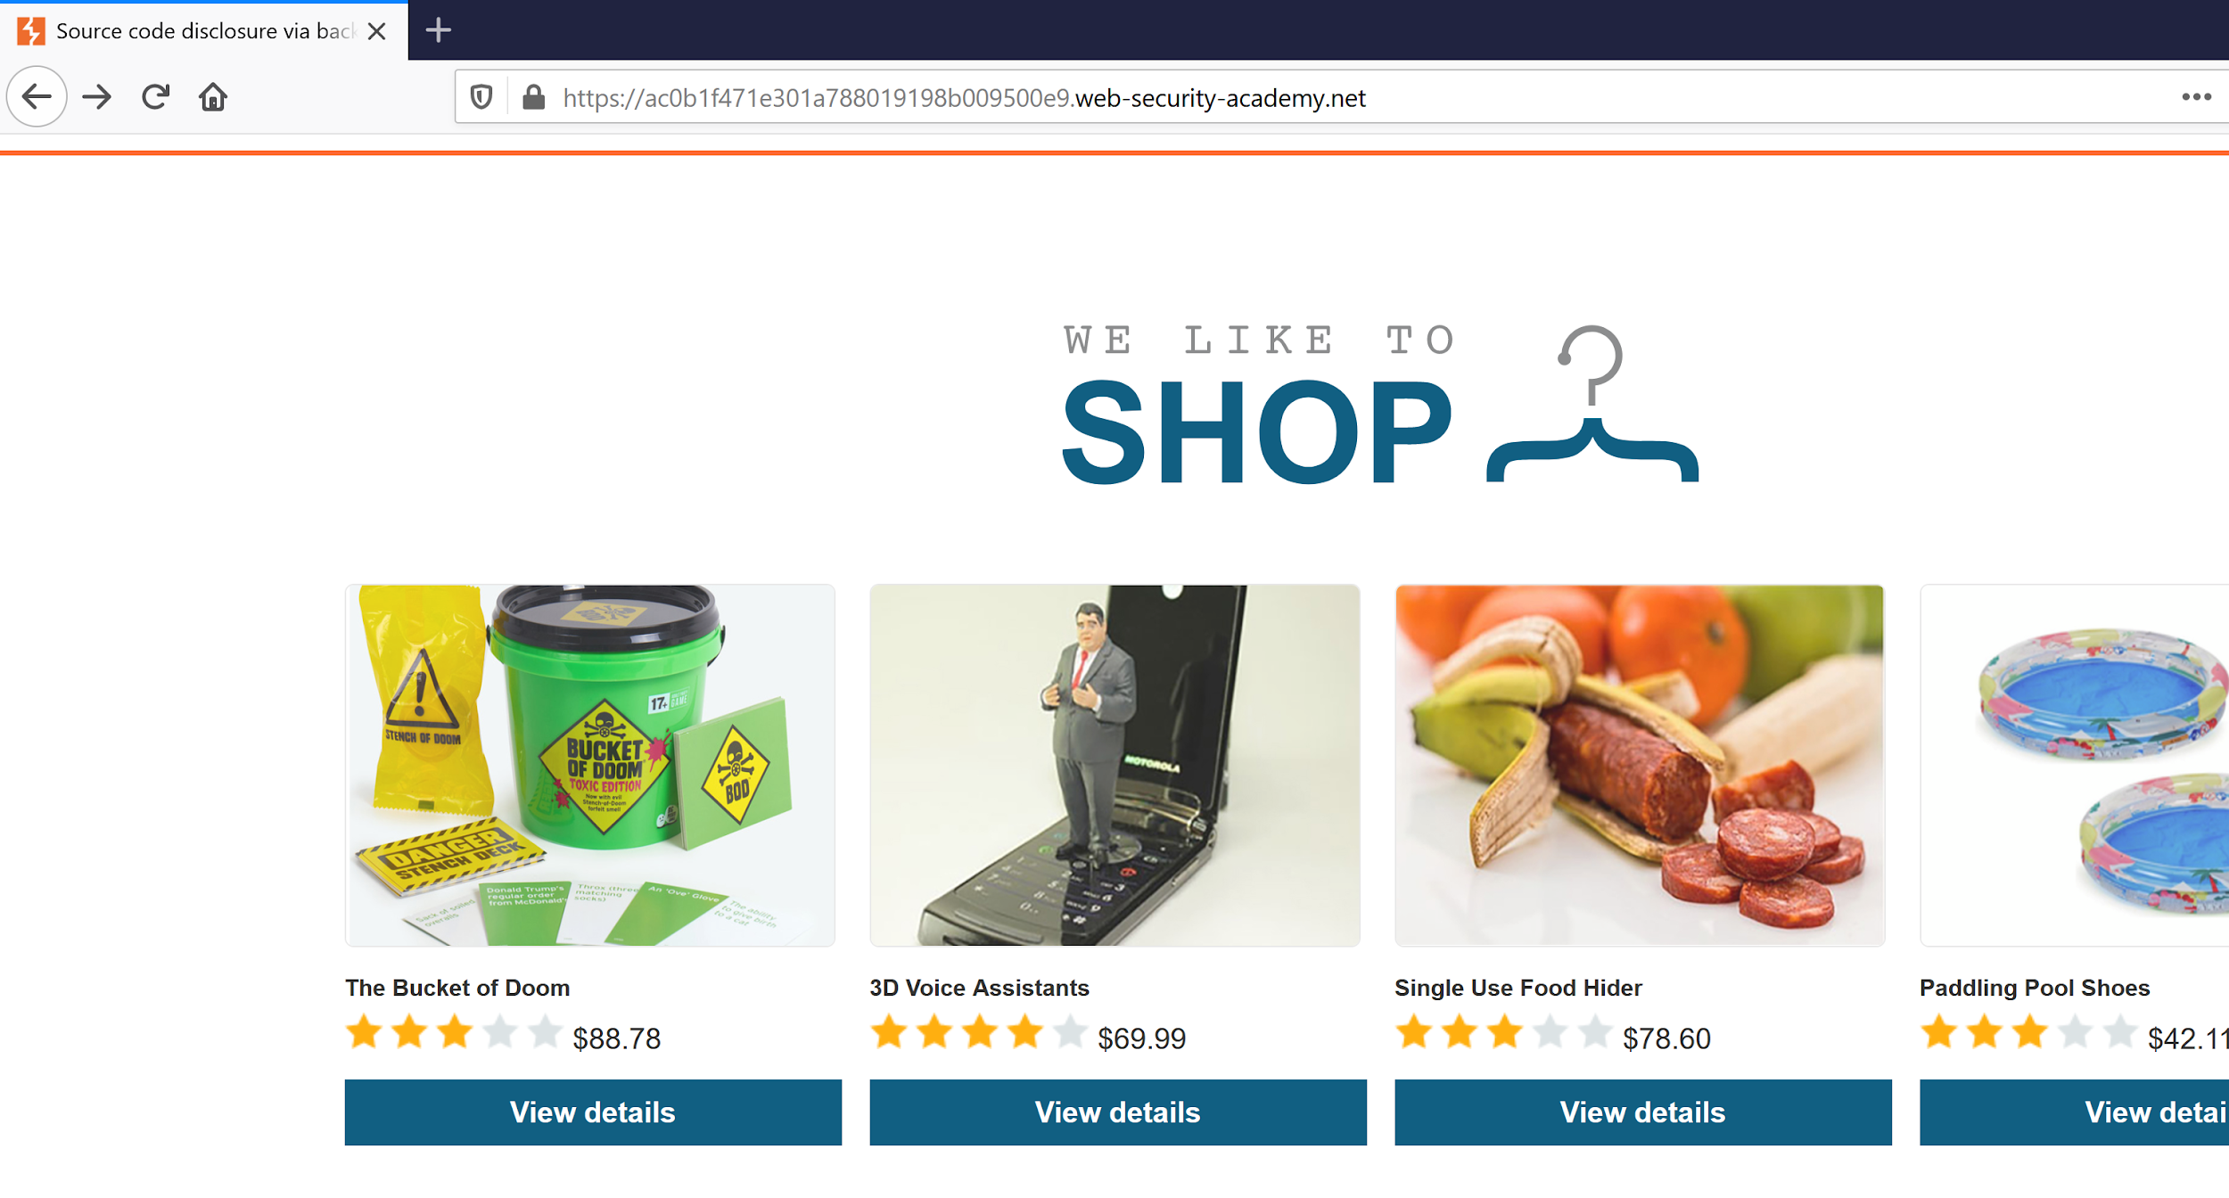
Types of Information Disclosure
Source Code Disclosure via backup files

Slide 38
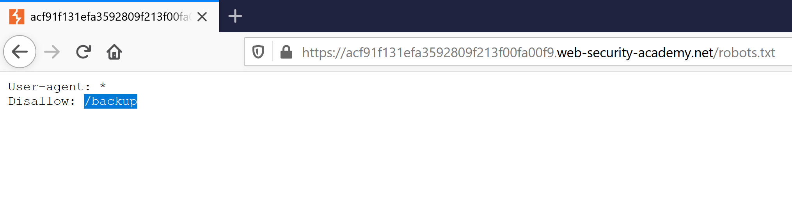
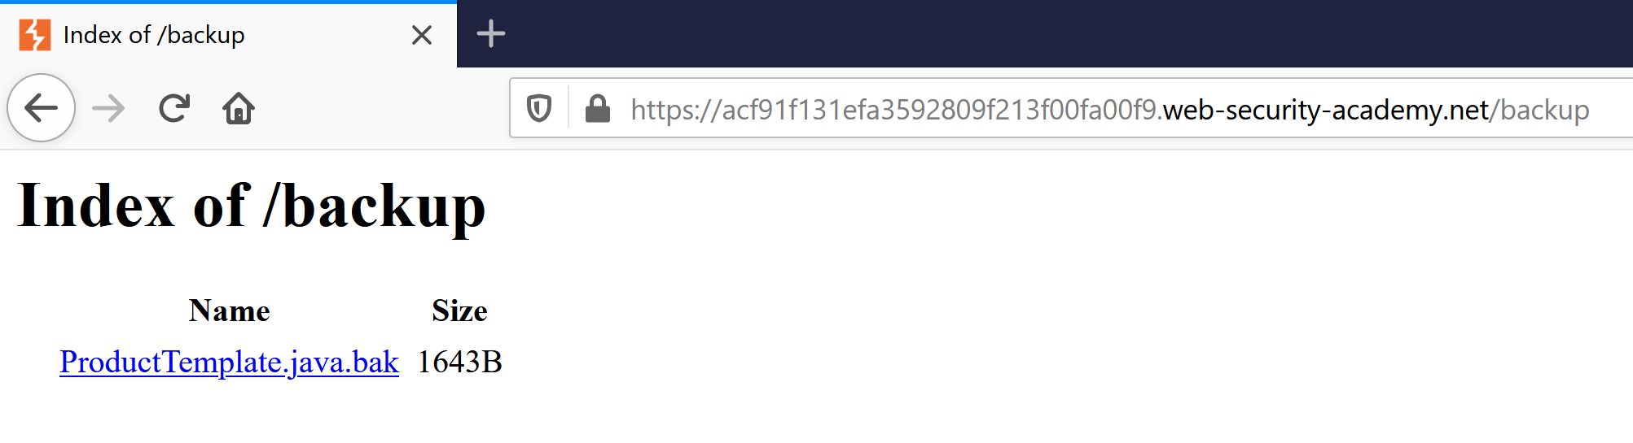

Slide 39
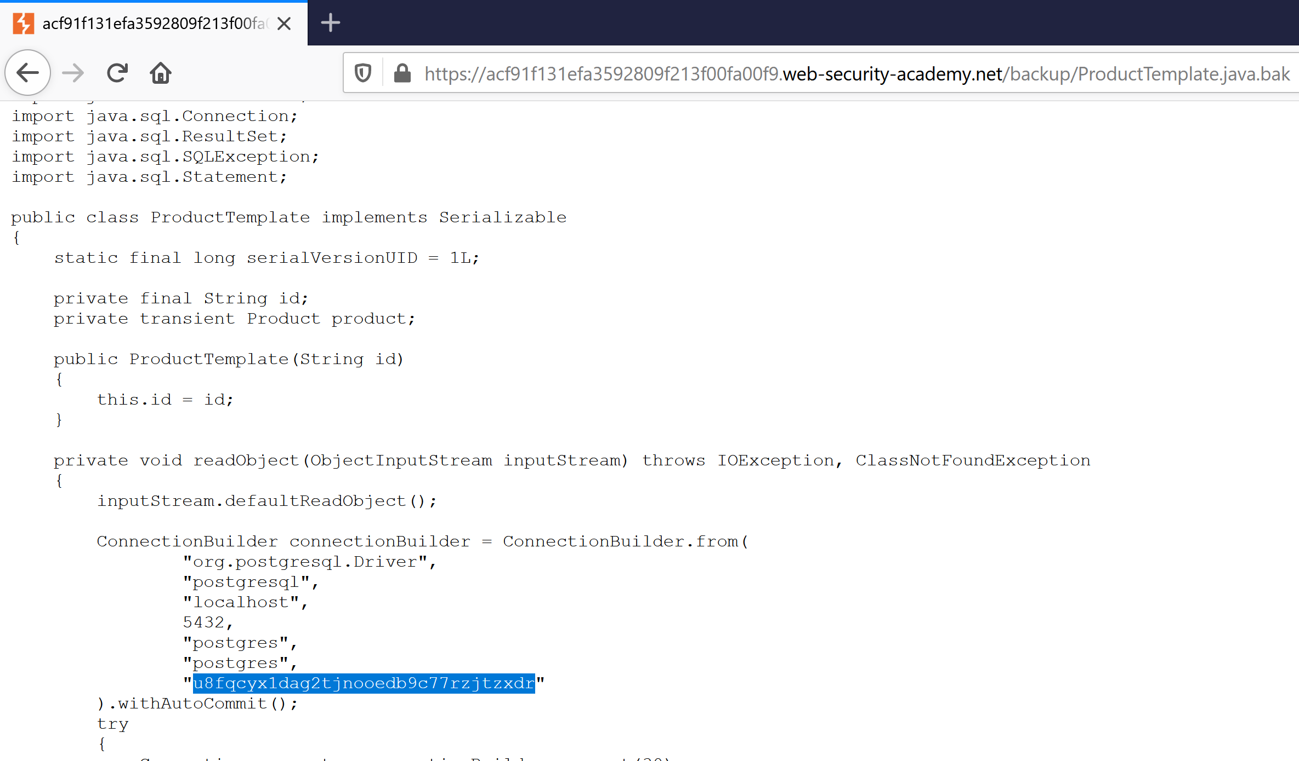

Slide 40
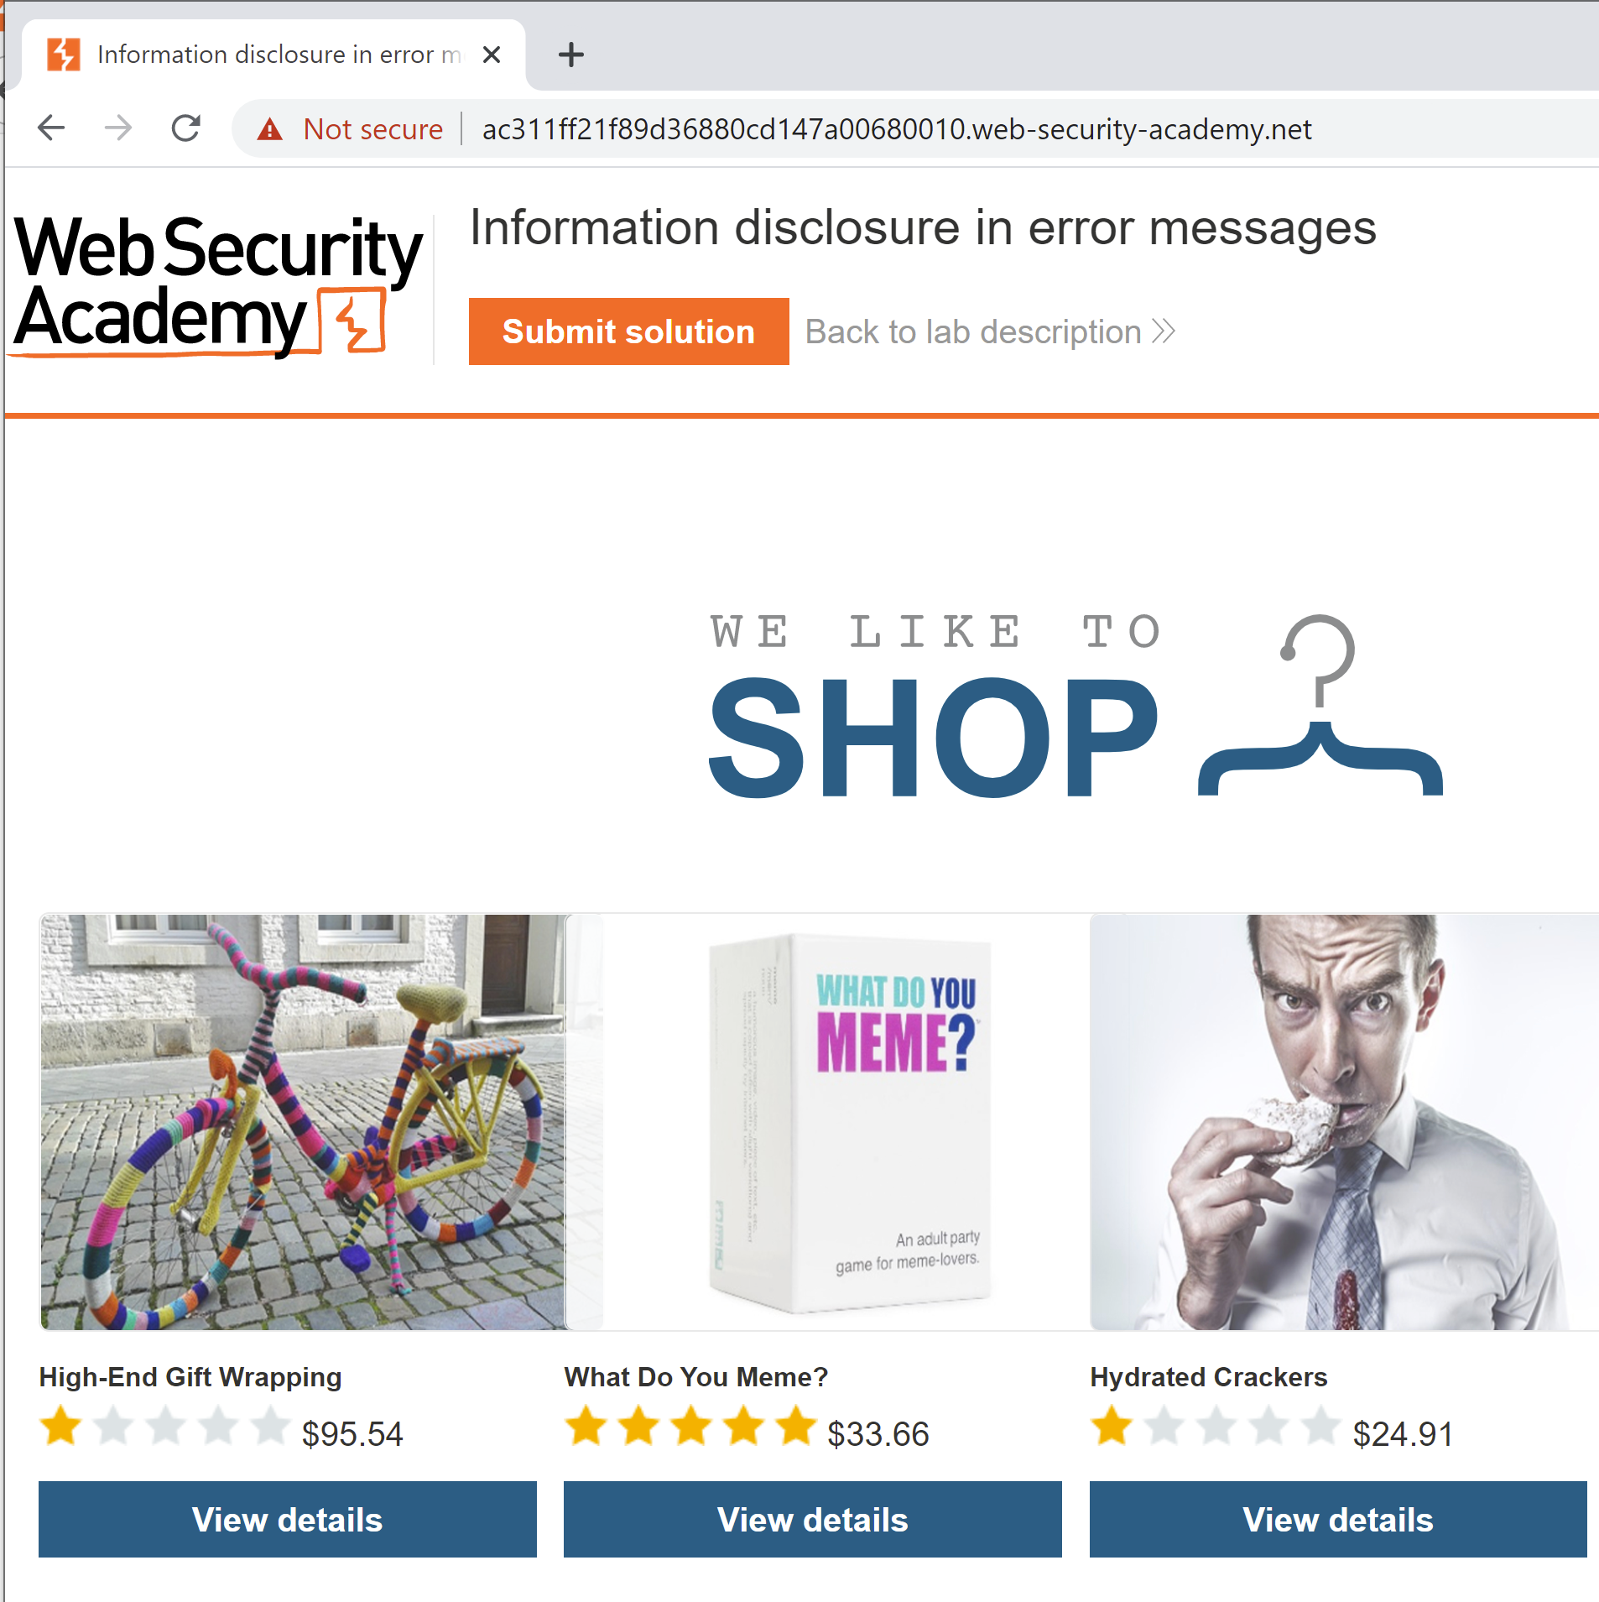
Information disclosure in error messages

Slide 41
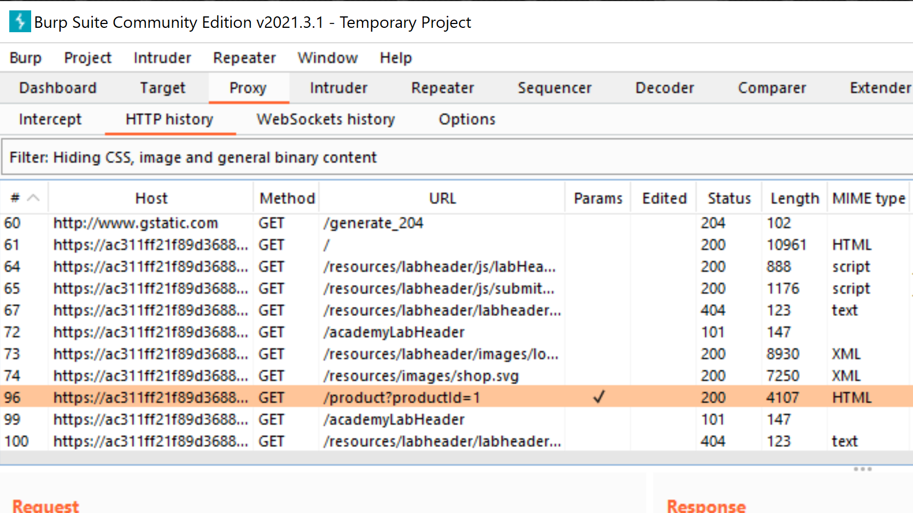

Slide 42
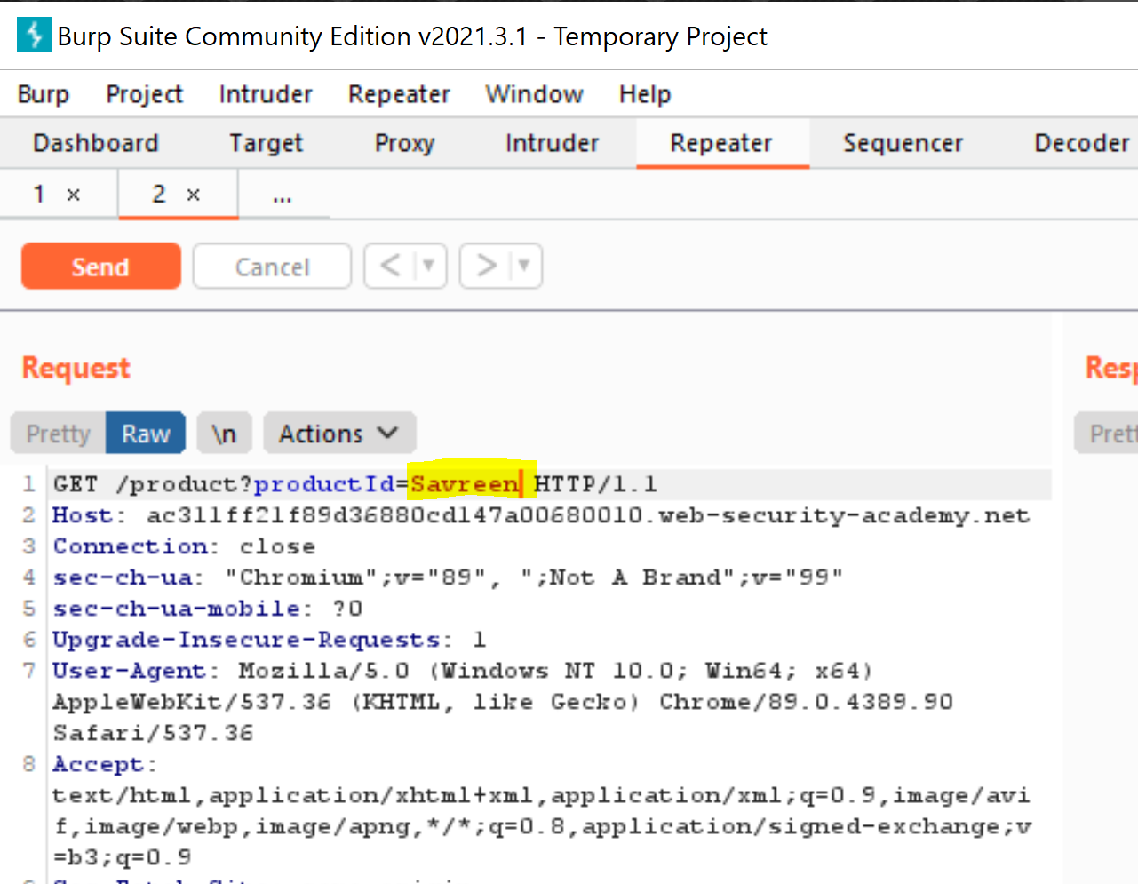

Slide 43
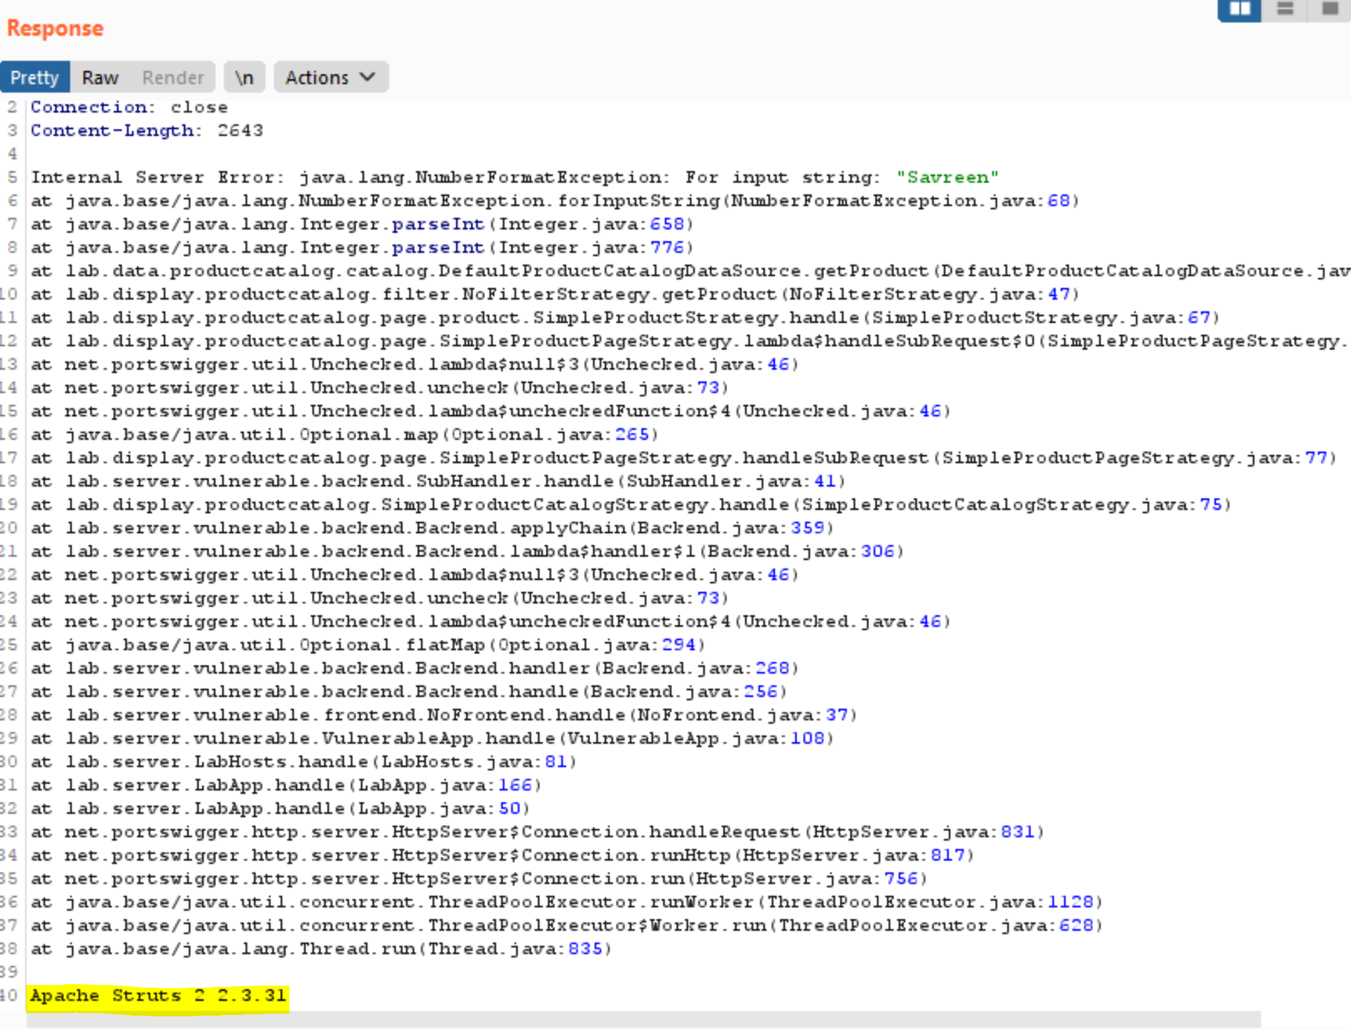

Slide 44
Authentication bypass via Information disclosure
Information disclosure in version control history
Information disclosure on debug page
Mitigation:
Web server should not send out response headers or background information
Services running on open ports don’t reveal information about builds and versions
Proper access controls and authorizations are in place

Slide 45
Takeaways
Recon is similar to meeting someone new
Host discovery is one of the very first steps in Recon
Websites/Applications can reveal a lot of information unintentionally

